Slide 1


Flashlight-based Emergency Evacuation System
Team : HotSource
Task Representative Student : Seon jae Kim
Team Member : Kim Seon Jae, Kim Hyeong Do, Park Moo chang, Jeong Seung Ju, Choi Min Seok

Slide 2
Table of Contents
Story
Idea Plan
Product Discription
Question and Answer

Slide 3
Story

Slide 4




Story
selection process
Emergency Vehicle Safe Path
What is Inconvenience and Danger in our Life?
Driving Front Sight
=>
Stop Drunk Driving
Emergency Flashlight
https://www.dreamstime.com/stock-illustration-busy-lazy-motivated-unmotivated-image67702743#res26615551
https://www.pinterest.co.kr/pin/816699713677702829/
https://www.freepik.com/premium-vector/drunk-driving-vector-alcoholic-driver-car-accident-infographic-illustration-with-diagram-set-alcohol-related-crashes-isolated-white_7928333.htm?epik=dj0yJnU9REdhVmpwLVA2aW1rZ2JnNnBJeXBrdlFzd1NvbHFtNW4mcD0wJm49S3Vnd1pmbGN0NUZGWEhNUTZiWFN5dyZ0PUFBQUFBR0NHeDcw
https://www.pinterest.co.kr/pin/65654107058173331/

Slide 5

STORY
Idea-related Social Issues
Evacuation problems of skyscrapers and Review of countermeasures through field surveys
Quantitative Evaluation of Evacuation Experience
There will be a lot of confusion if there is a real fire.
It was difficult to evacuate in the event of a disaster such as a building fire.
During the evacuation, I didn't know the floor I was on.
90%
88%
67%
https://icons8.com/icon/10808/exit-sign
https://scienceon.kisti.re.kr/srch/selectPORSrchArticle.do?cn=JAKO201030650219147

Slide 6
STORY
Make a Product
Where is User’s current Location?
How many People inside There?

Slide 7
Idea Plan

Slide 8


Idea plan
Product and Service
Application
Beacon Device
Emergency Flashlight Storage Box
Web Page
Emergency Flashlight

Slide 9

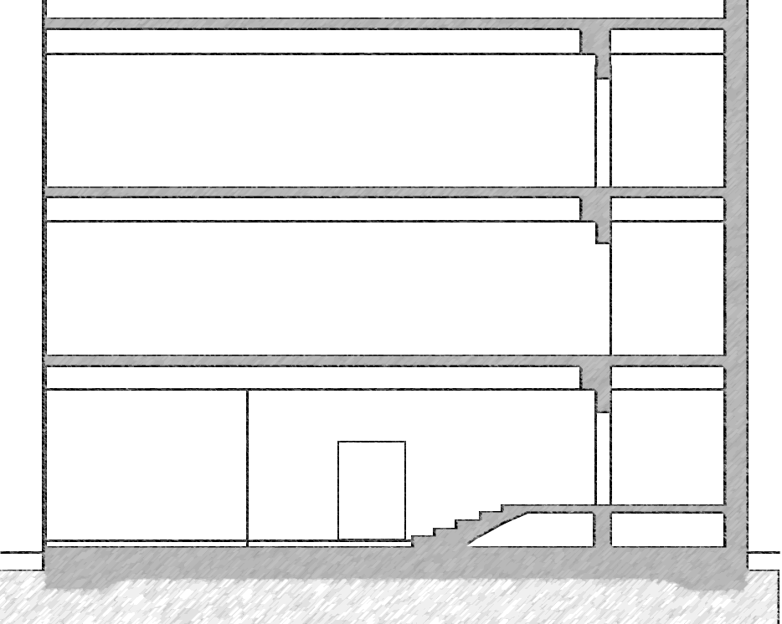

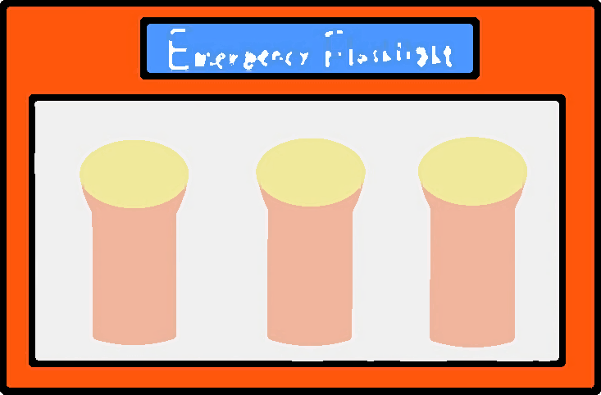






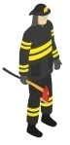
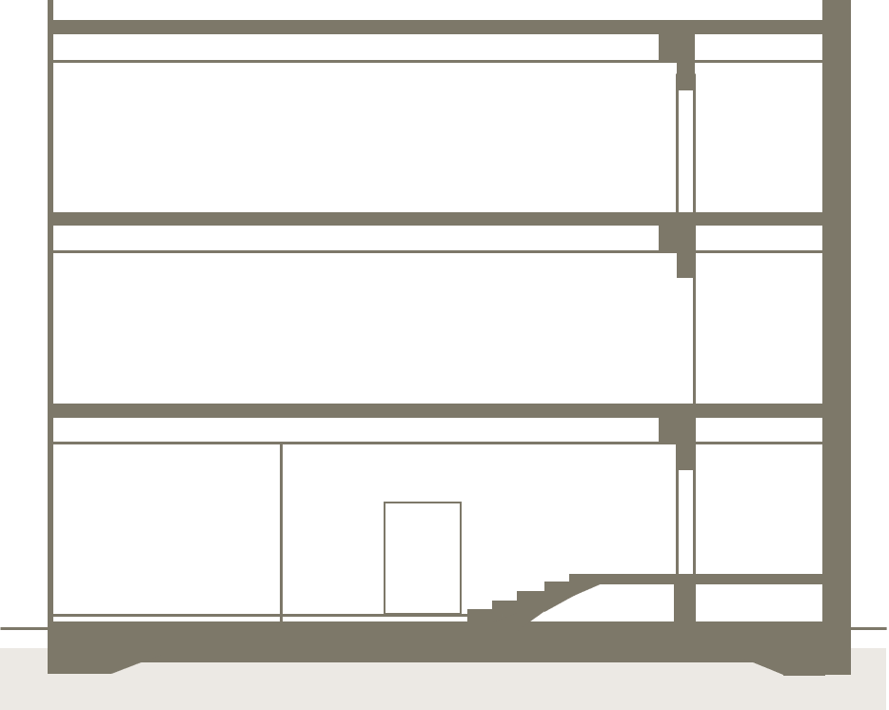


Idea plan
Process Diagram
https://www.pinterest.co.kr/pin/591590101050204698/
https://www.pinterest.co.kr/pin/235242780524469879/
https://www.pinterest.co.kr/pin/653303489695824533/
https://www.pinterest.co.kr/pin/570549846547134695/
https://www.pinterest.co.kr/pin/618119117578423331/
https://www.istockphoto.com/kr/%EB%B2%A1%ED%84%B0/office-table-vector-isometric-illustration-gm640115928-115762695
https://www.istockphoto.com/kr/%EB%B2%A1%ED%84%B0/monitor-vector-isometric-illustration-gm640115848-115762615
https://www.pinterest.co.kr/pin/820992207057737042/
https://www.pinterest.co.kr/pin/720083427905471099/

Slide 10

Idea plan
Social Expected Effects
2019 January National Police Agency Press Release
Beacon
50 Meters Apart
We can keep the golden time to save people who need help.
https://www.pinterest.co.kr/pin/512636370090290855/

Slide 11
Idea plan
Team Role
Kim Seon Jae
HW Design , Test
Park Moo Chang
Kim Hyeong Do
HW Design, Web UI
Application UI , UX
Choi Min Seok
Jeong Seung Ju
HW Design, Development
Server and Back-end

Slide 12
Idea plan
Advance Schedule and Total Cost

Slide 13
Production Descriptions

Slide 14
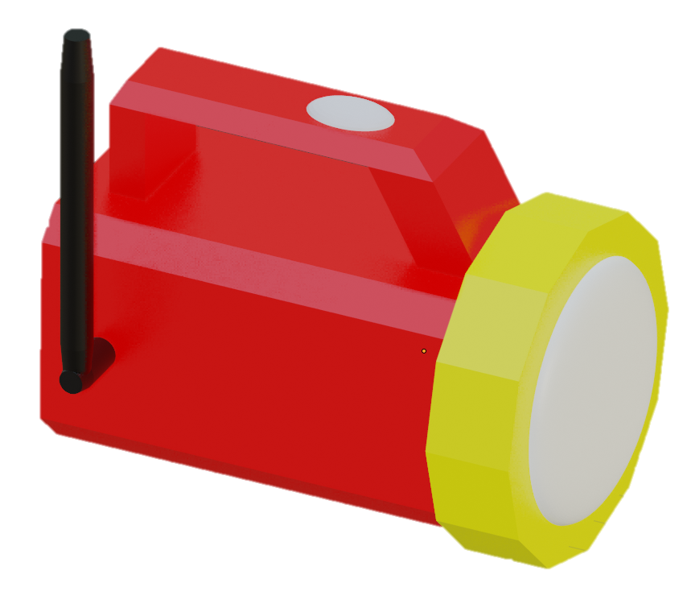

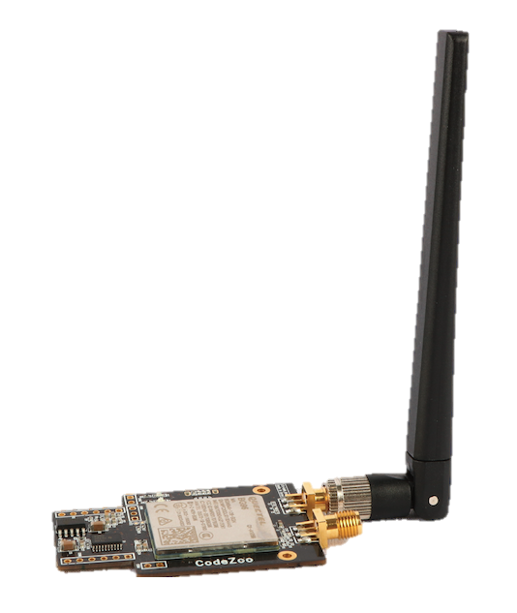
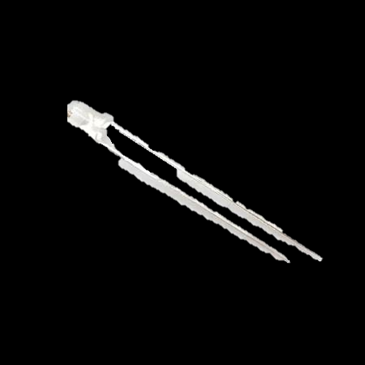
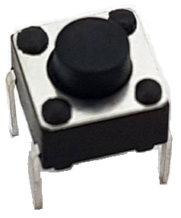
Production Descriptions
Flashlight
Feature Description
Receive a Location ID from the connecting Beacon
Send the Location ID to the Server
Turn On and Off the LED Light
Function Module
Raspberry Pi 4B Cat Module Antenna Button Module White Led
https://www.devicemart.co.kr/goods/view?no=12553062
https://www.devicemart.co.kr/goods/view?no=12843449
https://www.devicemart.co.kr/goods/view?no=1361702
https://www.devicemart.co.kr/goods/view?no=10918319

Slide 15
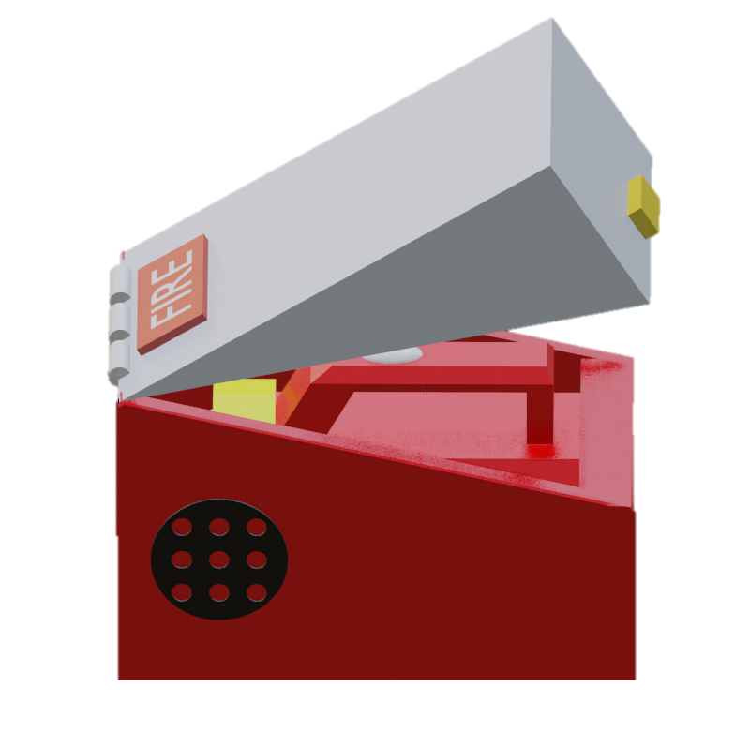

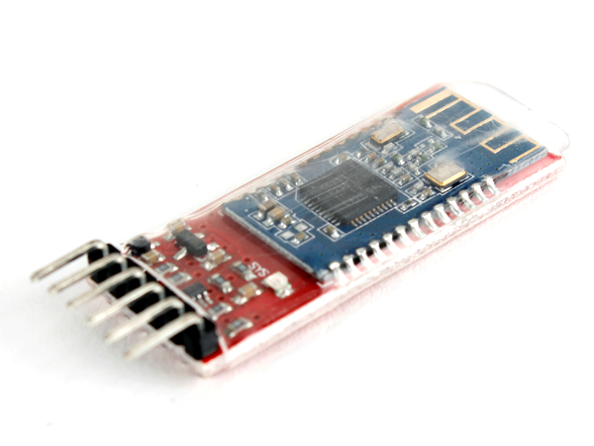
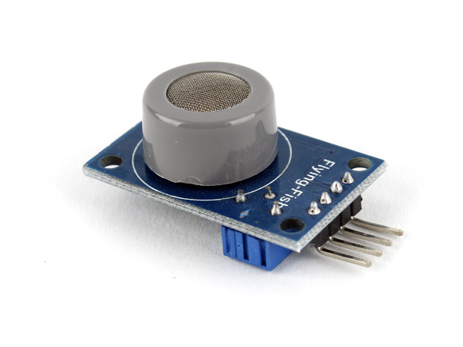
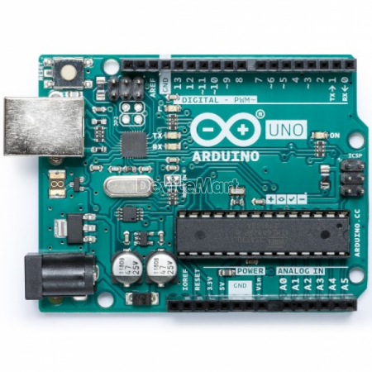
Production Descriptions
Storage Box and Beacon Device
Feature Description
1. Provides a Location ID for the connected device
Feature Description
Collecting Information by Sensor
Send Collected data to Server
Function Module
Bluetooth Module
Function Module
Air Sensor Cat or Wifi Module Arduino Uno
https://www.pinterest.ca/pin/619948704924985831/
https://www.devicemart.co.kr/goods/view?no=1341527
https://www.devicemart.co.kr/goods/view?no=1327402
https://www.devicemart.co.kr/goods/view?no=12843449
https://www.devicemart.co.kr/goods/view?no=34404

Slide 16



Production Descriptions
Web Server
Development Tools
Apache TOMCAT 9.0.45
MariaDB 10.5.9
https://hub.docker.com/_/tomcat
https://meterpreter.org/mariadb-mysql-branch-version/
Feature Description
Update Location data with Beacon ID when Flashlight or Mobile Phone send
Provide Images and Location data required by Web Pages and Application
https://www.pinterest.ca/pin/386676317989799109/

Slide 17


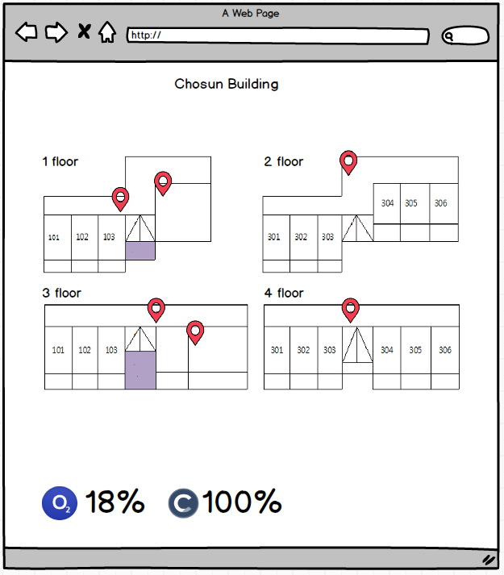
Production Descriptions
Web UI
Development Tools
Visual Studio CODE (HTML5, CSS3, JavaScript)
https://www.pinterest.ca/pin/840765824185353914/
https://www.pinterest.ca/pin/43347215146856983/
Feature Description
Display the Location of Evacuees in the Building By Pin-point on the Building Section
Display Sensor data stored on the Server
https://www.pinterest.co.kr/pin/720083427905471099/
https://www.chosun.ac.kr/user/indexSub.do?codyMenuSeq=257158&siteId=dorm

Slide 18
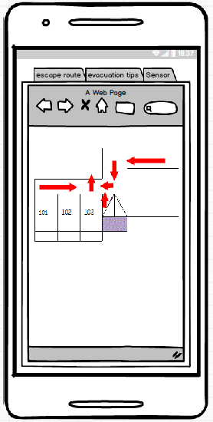
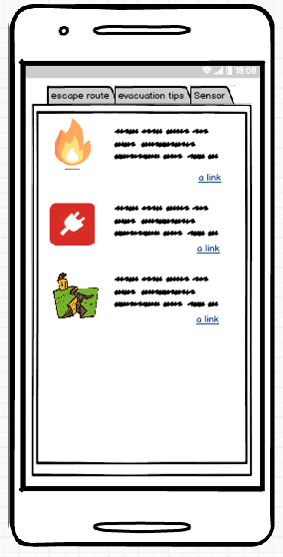
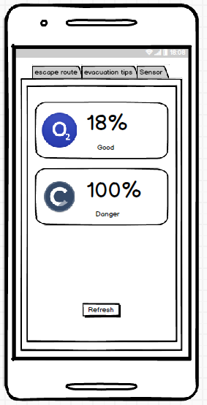

Production Descriptions
Application UI
Development Tools : Android Studio
Feature Description
Escape route : Show Escape route
Evacuation tips : Provides emergency evacuation information
Sensors : Show information collected by Sensor
< 1 >
< 2 >
< 3 >
https://kr.seaicons.com/%EC%82%B0%EC%86%8C-%EC%95%84%EC%9D%B4%EC%BD%98-2/
https://www.pinterest.ca/pin/466896686374947261/
https://www.pngwing.com/ko/free-png-brszr
https://pixabay.com/ko/vectors/%EC%A7%80%EC%A7%84-%EC%9E%AC%ED%95%B4-%EC%B6%95%EC%86%8C-%EC%A7%91-5657776/
https://iconicons.com/ko/%EC%95%84%EC%9D%B4%EC%BD%98/%ED%83%84%EC%86%8C-%EB%B3%B5%EC%82%AC-cloner/30254
https://www.pngegg.com/ko/png-kirig/

Slide 19
Question and Answer
Thank you for Listening
Please ask any Question

